Slide 1

Cartify – "Your Ultimate Shopping Destination"

Slide 2

Overview
Cartify is an innovative e-commerce marketplace designed to provide a seamless and efficient shopping experience. Our vision is to revolutionize online shopping by integrating AI-driven recommendations, a user-friendly interface, and secure transactions.

Slide 3

Problem Statement
Identified Problem:
Consumers struggle with:
Inefficient product discovery
Lack of personalized shopping experiences
Unreliable sellers and unverified products
Security concerns in transactions
Supporting Data:
74% of consumers feel overwhelmed by the variety of online products.
60% of users abandon carts due to a lack of trust in sellers.
Online fraud cases have increased by 30% in the last two years.

Slide 4

Solution
Cartify provides:
AI-driven product recommendations for better discovery
Verified sellers to ensure authenticity
Secure payment gateways and buyer protection
Seamless integration of third-party logistics for efficient delivery

Slide 5

Market Opportunity
Market Size & Growth Potential:
The global e-commerce market is projected to reach $8.1 trillion by 2026.
90% of internet users make at least one online purchase annually.
Mobile commerce is growing at a 35% annual rate.

Slide 6
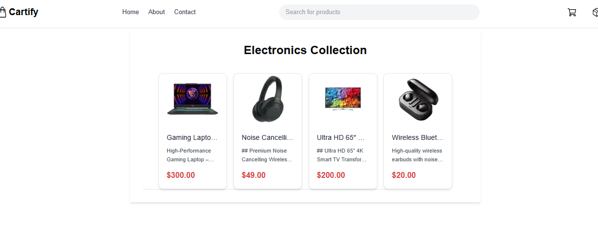
Key Features:
AI-based personalized shopping experience.
Secure payment processing.
Seamless user interface and UX design.
Verified sellers and product authentication.
Integration with Sanity CMS for efficient content management

Slide 7

Marketing Strategy
Customer Acquisition:
Social media marketing & influencer collaborations
SEO-optimized content & paid advertising
Referral programs & customer incentives
Customer Retention:
Personalized shopping experience
Exclusive member discounts & rewards
Loyalty programs

Slide 8

Call to Action
We are seeking:
Funding: To scale our operations and enhance platform features
Partnerships: With logistics and payment service providers
Mentorship: To refine our business strategy and expansion plans

